Slide 1
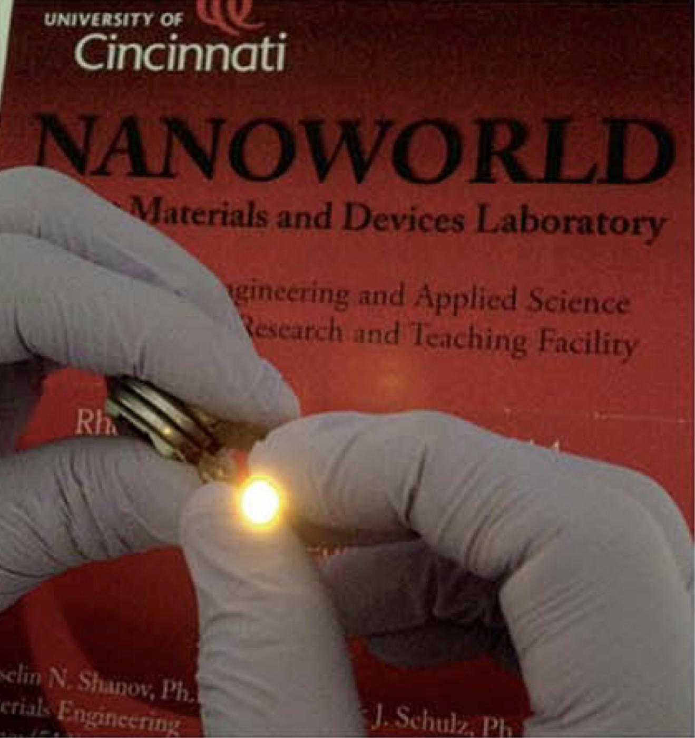
Bi-Weekly Update
By: Victoria Jones
&
Ramya Ravindrababu
Image source: J. Mater. Chem. A, 2016,4, 1876-1886

Slide 2
Victoria Jones
Integrated Science and Introduction to Chemistry Teacher
Beechwood High School, Fort Mitchell, Kentucky

Slide 3
Ramya Ravindrababu
Math Teacher
Betsy Layne High School, Floyd County, Kentucky

Slide 4
Table of Contents
Introduction
Abstract
Literature Review
Current Limitations
Proposed Study Tasks
Research Progress and Results
Unit Topics

Slide 5
Introduction
Energy storage is becoming a primary target for research and optimization due to renewable energy concerns. Graphene is a material currently used as an electrode in Li chemistry batteries. We want to improve Na chemistry batteries because they are cheaper and easier to dispose of. To optimize graphene we add Nitrogen to the graphene structure.
We are HERE with Na batteries
?$
Theory
Research
Mass Production

Slide 6
Abstract
Graphene is a material highly suited to performing as the electrode in batteries.
Li batteries are the primary current type
Na batteries have several benefits but don’t yet have the testing and optimization that Li batteries have
Graphene needs to be optimized to serve as the electrode in Na batteries

Slide 7
Energy Storage
Literature Review & Limitations

Slide 8
Why do we care about energy storage?

Slide 9
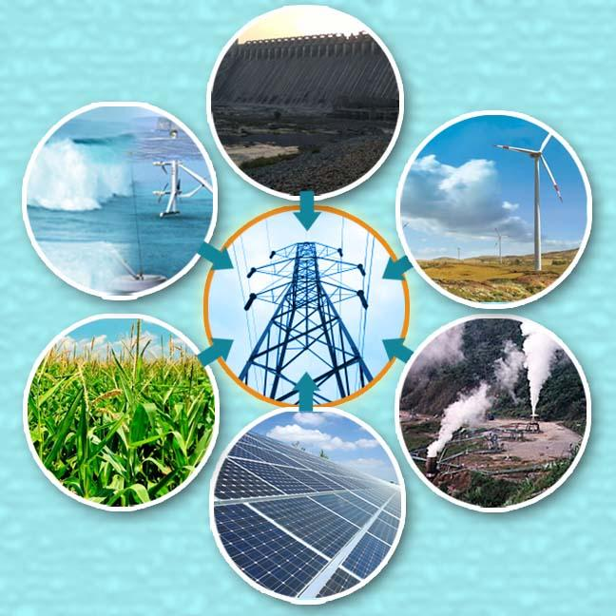
Image source: http://aniruddhafriend-sangitaashokvartak.blogspot.com
Renewable Energy
Portability
Image source: macworld.com

Slide 10
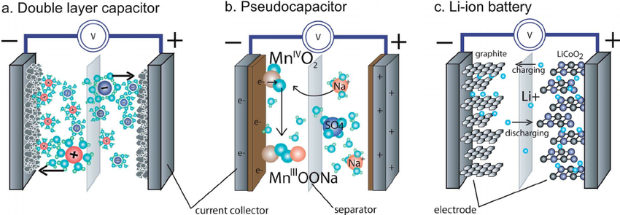
Mechanisms of Energy Storage
Image Source: researchgate.net

Slide 11
Li⁺ Batteries
Discussing Limitations

Slide 12
Li⁺ Batteries
Well- tested
Commercially available
EXPENSIVE

Slide 13
Na⁺ Batteries
A New Way Forward

Slide 14
Na⁺ Batteries
Cheaper to produce
Easier to dispose of
More massive
Does not independently intercalate with graphene

Slide 15
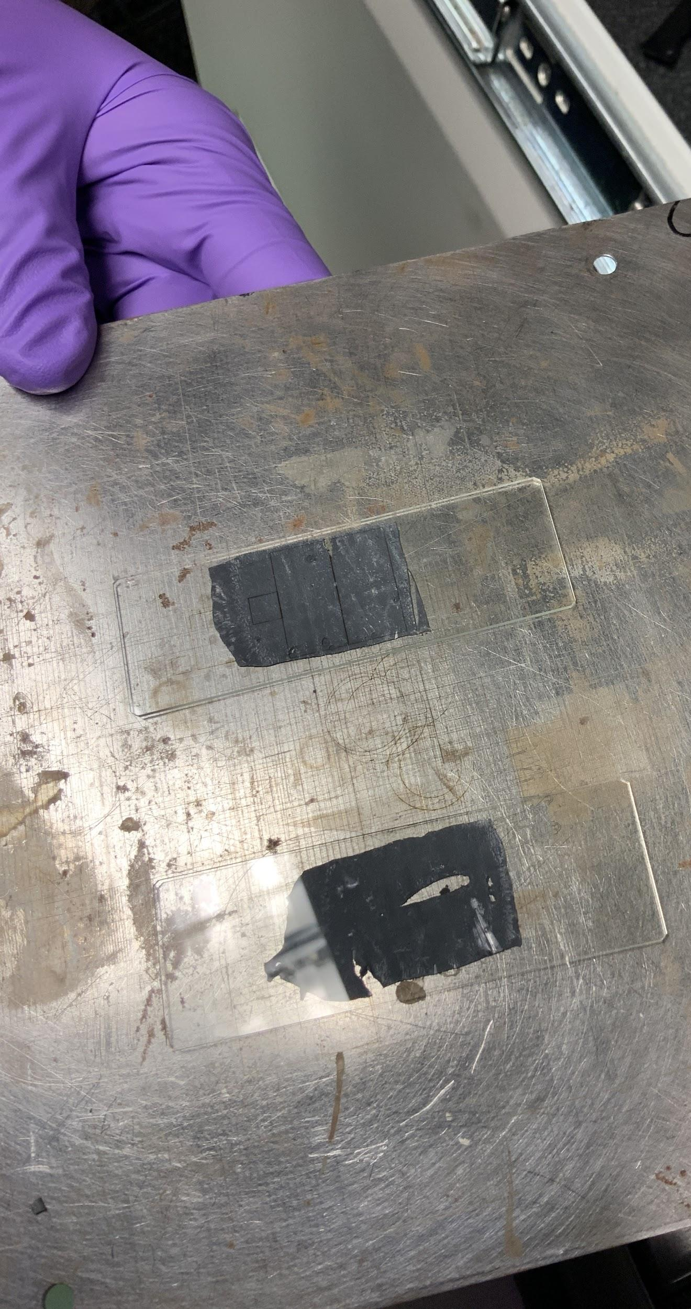
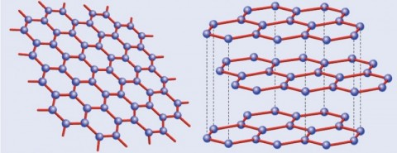
3D graphene
Graphene can serve as the electrodes in both Li and Na batteries.
Image source: https://graphene.nus.edu.sg/what-exactly-is-graphene/

Slide 16
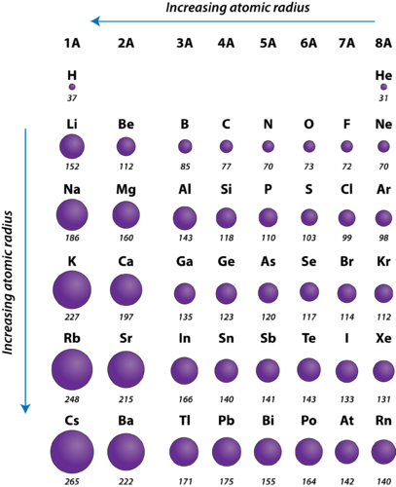
Fixing the intercalation problem
Image Source: https://courses.lumenlearning.com/cheminter/chapter/periodic-trends-atomic-radius/

Slide 17
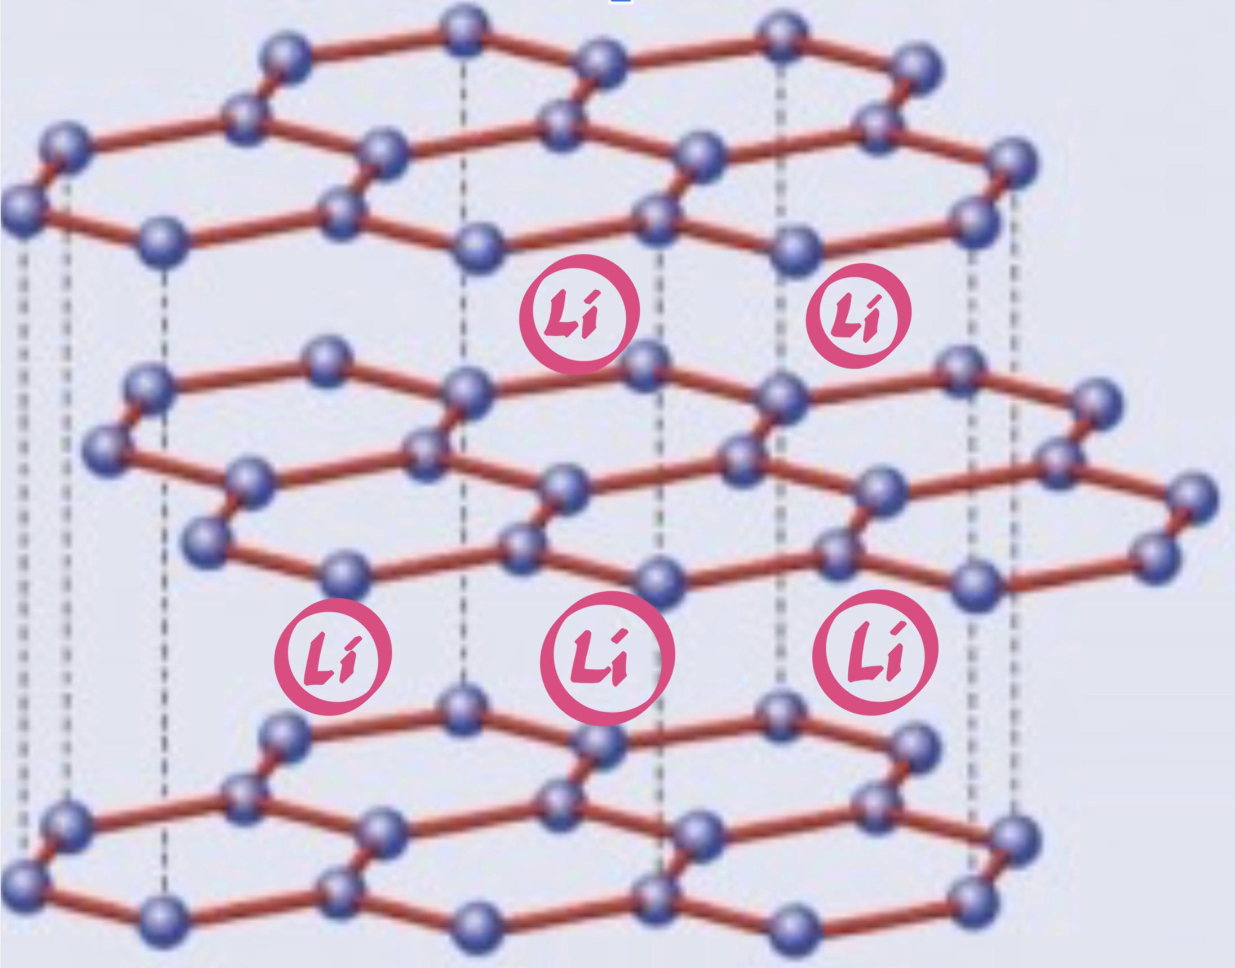
Image source: https://graphene.nus.edu.sg/what-exactly-is-graphene/
Image source: https://graphene.nus.edu.sg/what-exactly-is-graphene/

Slide 18
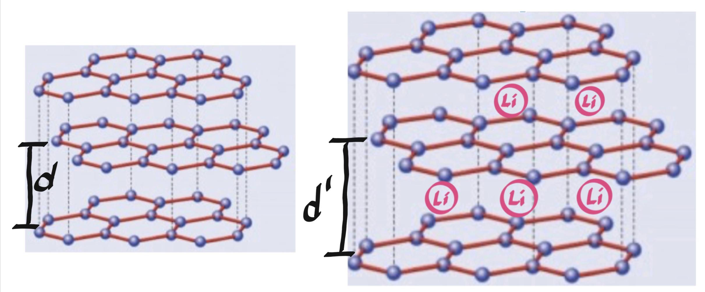
Image source: https://graphene.nus.edu.sg/what-exactly-is-graphene/

Slide 19
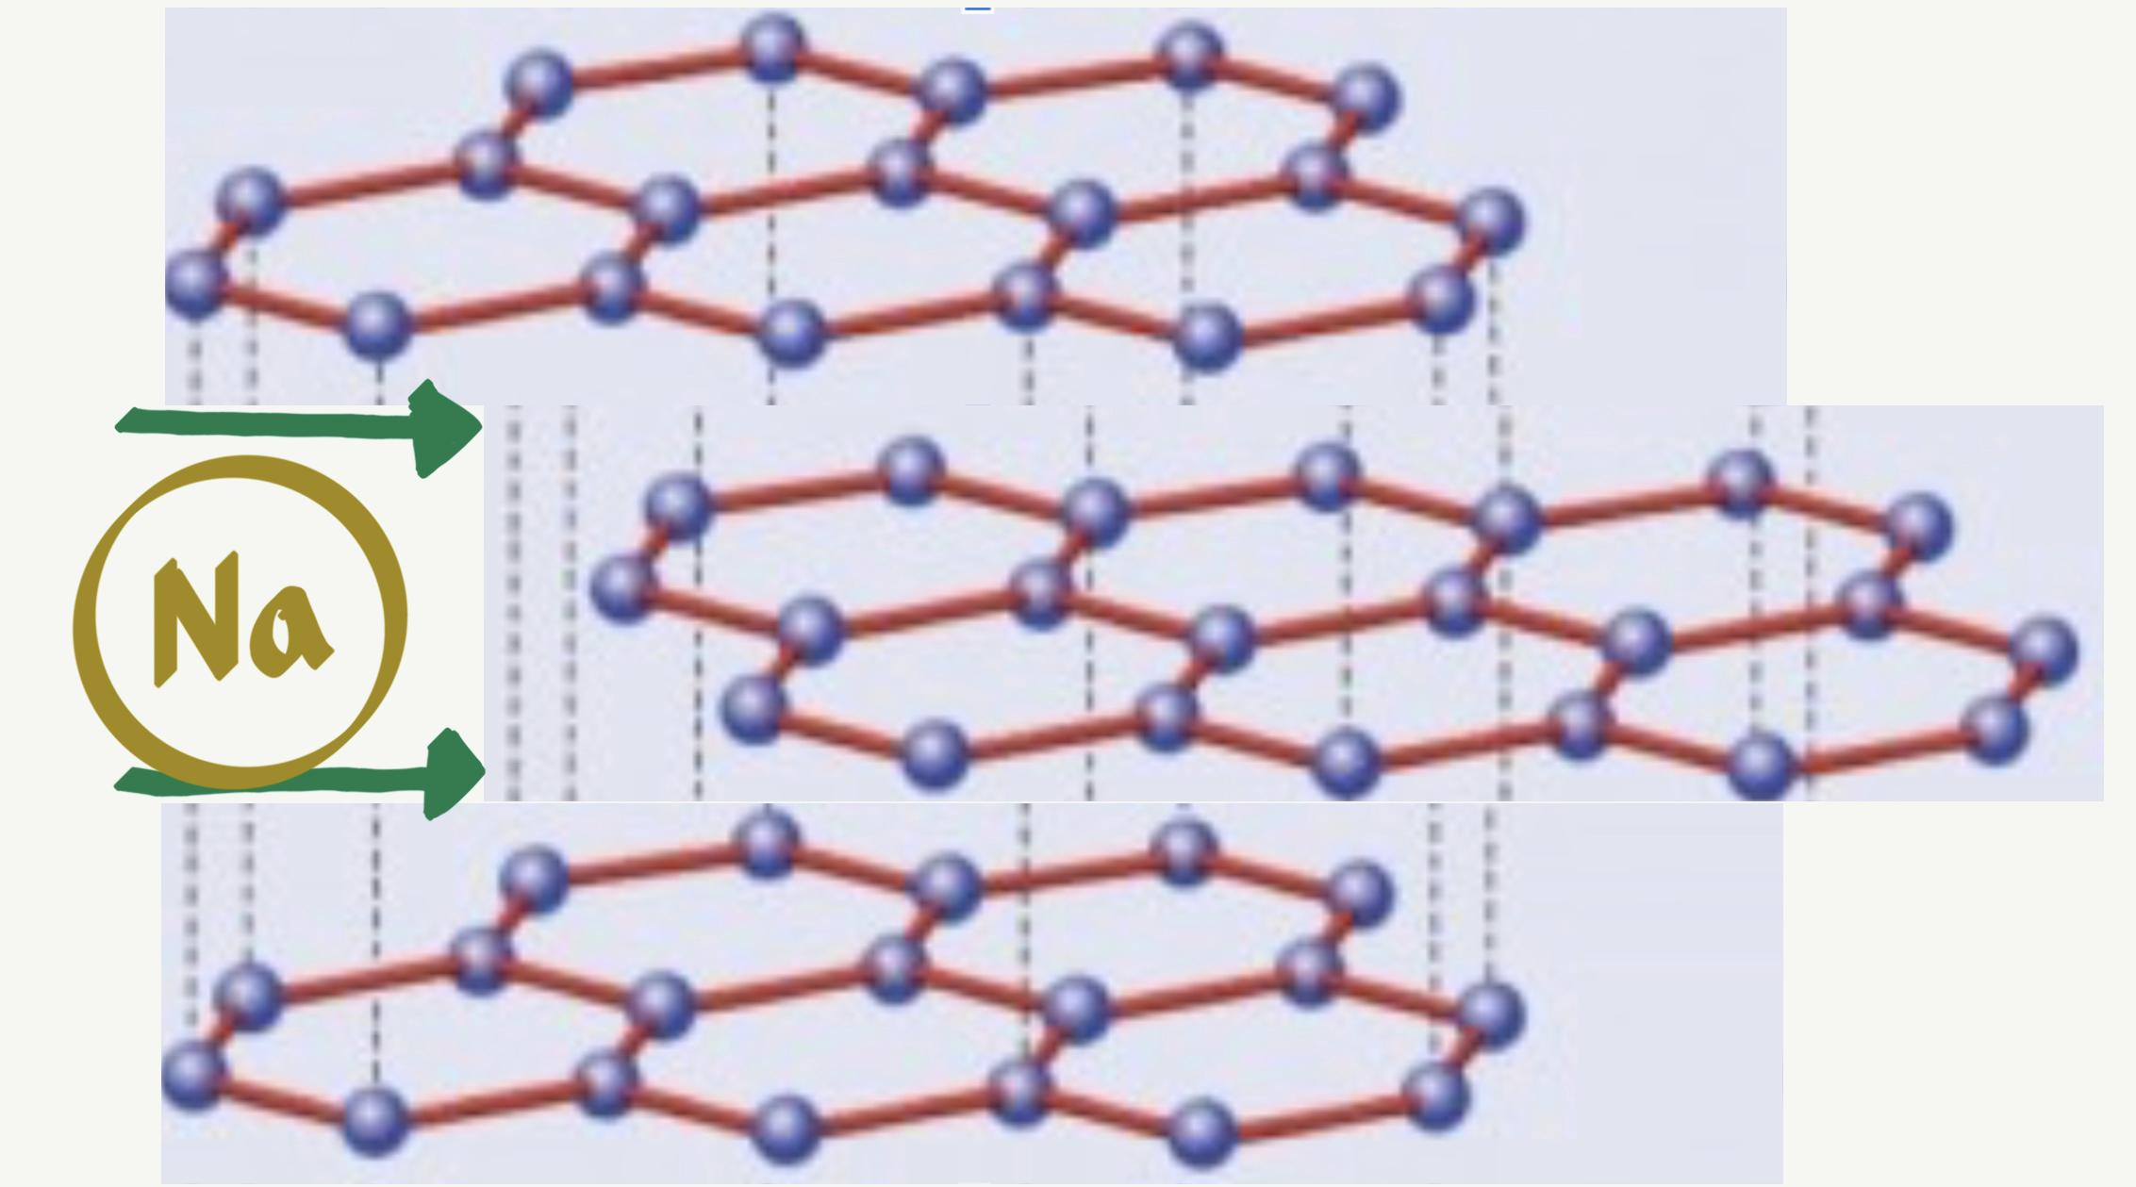
Image source: https://graphene.nus.edu.sg/what-exactly-is-graphene/

Slide 21
Beyond Graphene Foam Key Points
What’s Graphene Foam and what are its properties?
Graphene foam (GF) is a 3D structure previously studied for use in batteries.
Benefits of GF include - high specific surface area, fast electrons transfer.
The Electrical conductivity of GF is unsatisfactory - ~1 S cm^(-1)
The macropores, while increasing SA actually decrease the conductivity of the foam.
Created using Chemical Vapor Deposition (CVD process) and it gets its porous structure from the expensive Nickel foam used in creation.

Slide 22
Refining
CVD as a method is effective - results in high purity and low defect concentration, but the catalyst itself needs to be changed.
Current Ni catalysts aren’t providing efficient and inexpensive foundations for graphene synthesis.

Slide 23
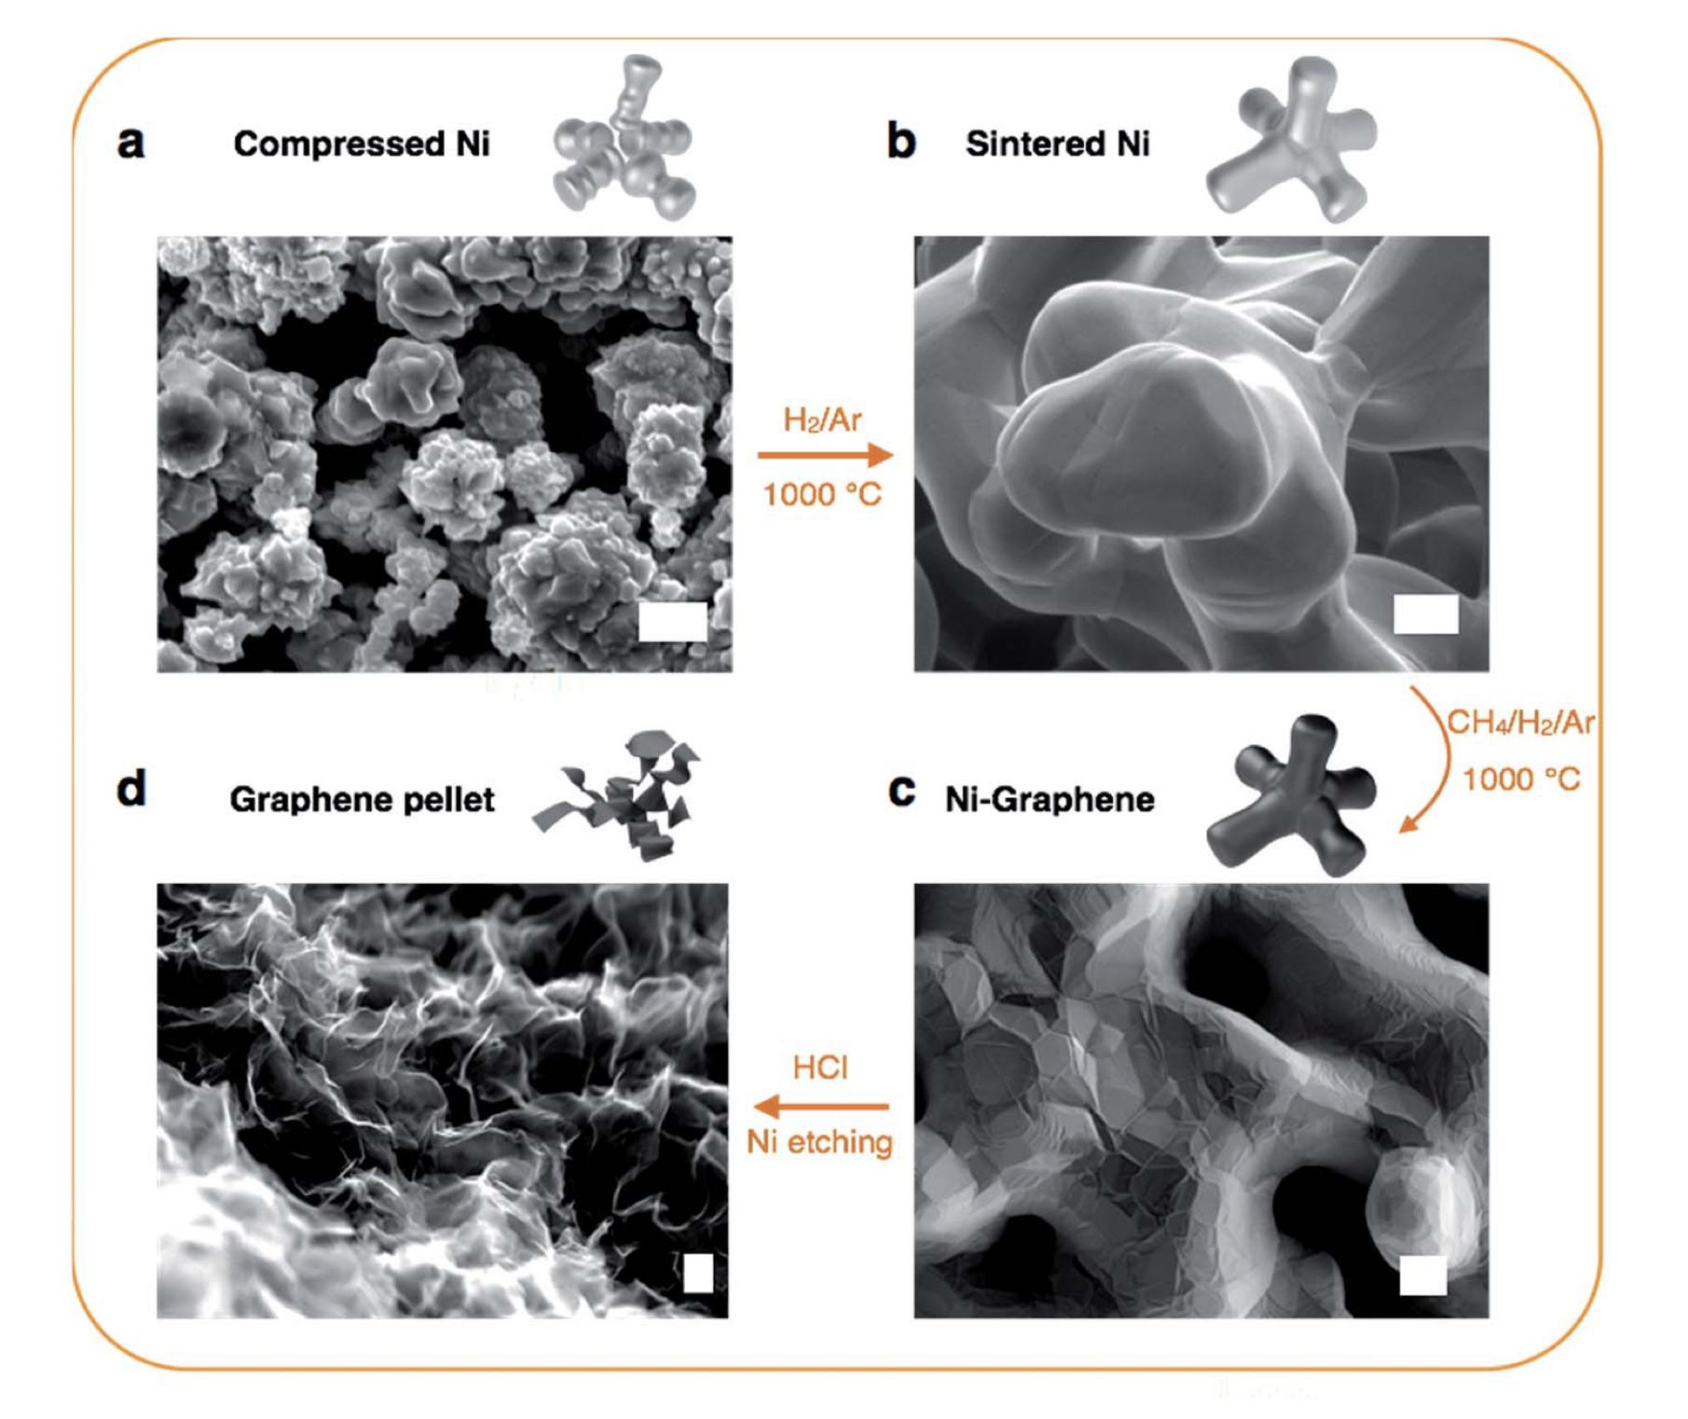
Image source: J. Mater. Chem. A, 2016,4, 1876-1886

Slide 24
Electrical Conductivity
Image source: J. Mater. Chem. A, 2016,4, 1876-1886

Slide 25
Surface Area & Porosity
Image source: J. Mater. Chem. A, 2016,4, 1876-1886

Slide 26
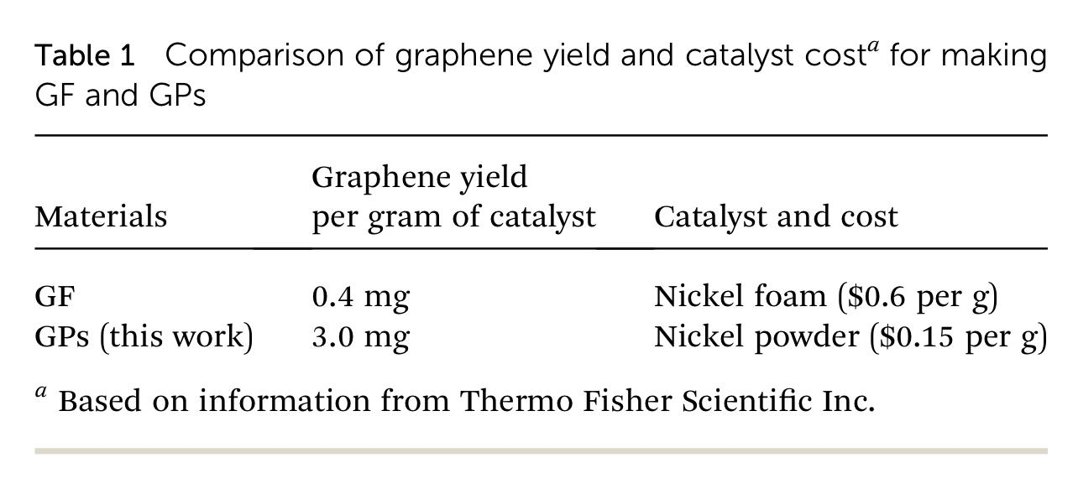
Image source: J. Mater. Chem. A, 2016,4, 1876-1886

Slide 27
Next steps
We know graphene is a good housing, so now we’re going to use it to house Na and we’re going to optimize the graphene by doping it with Nitrogen.

Slide 28
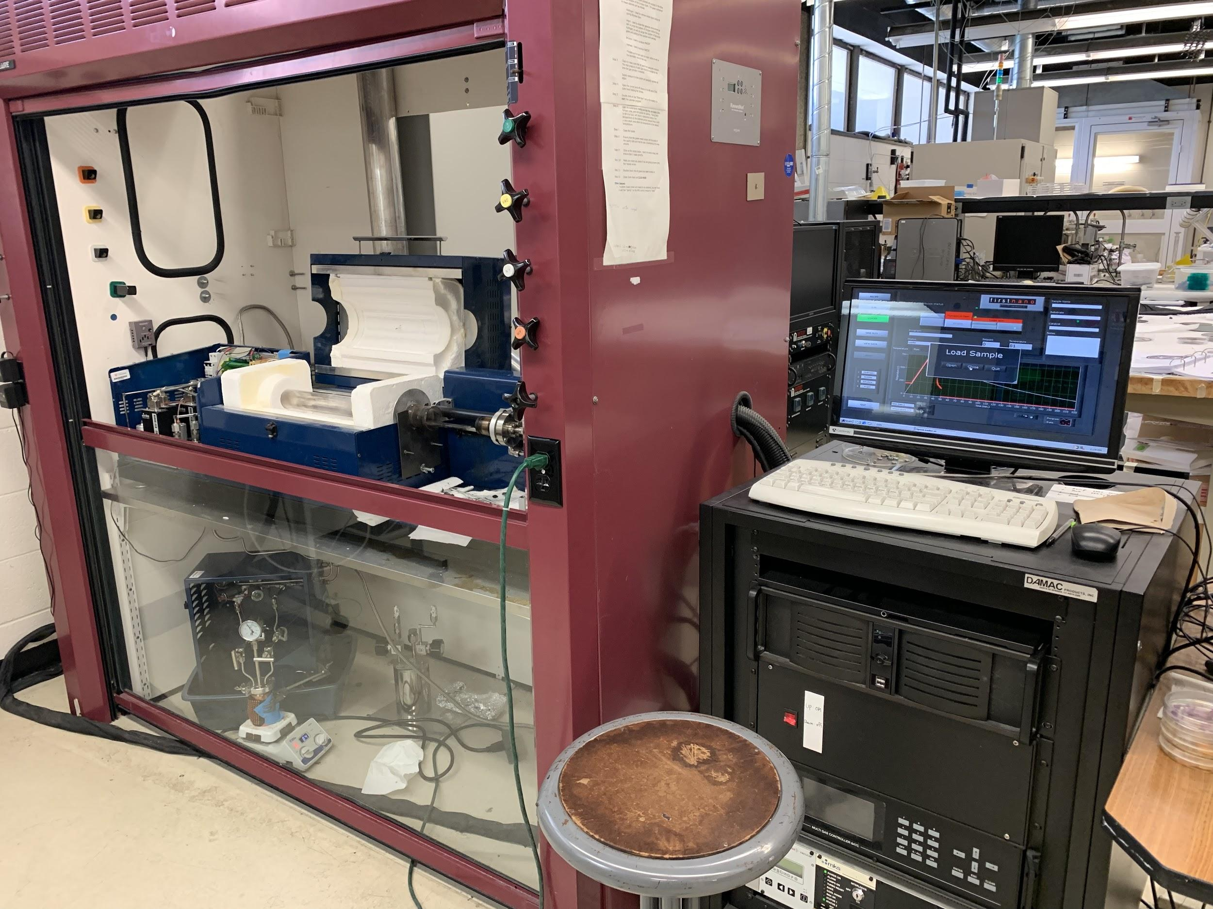
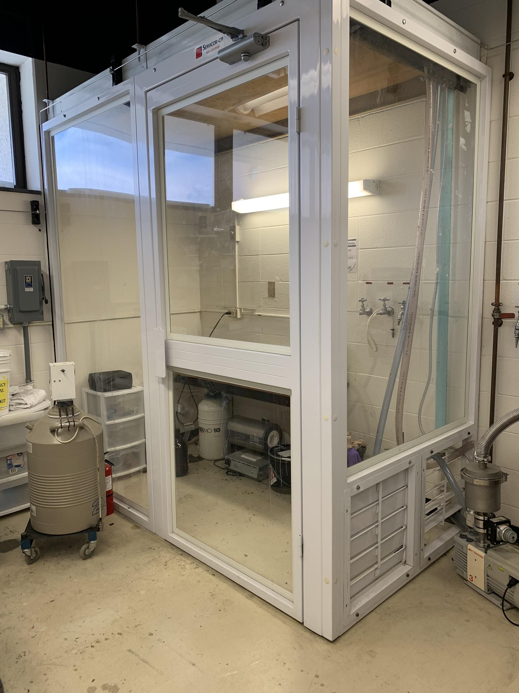
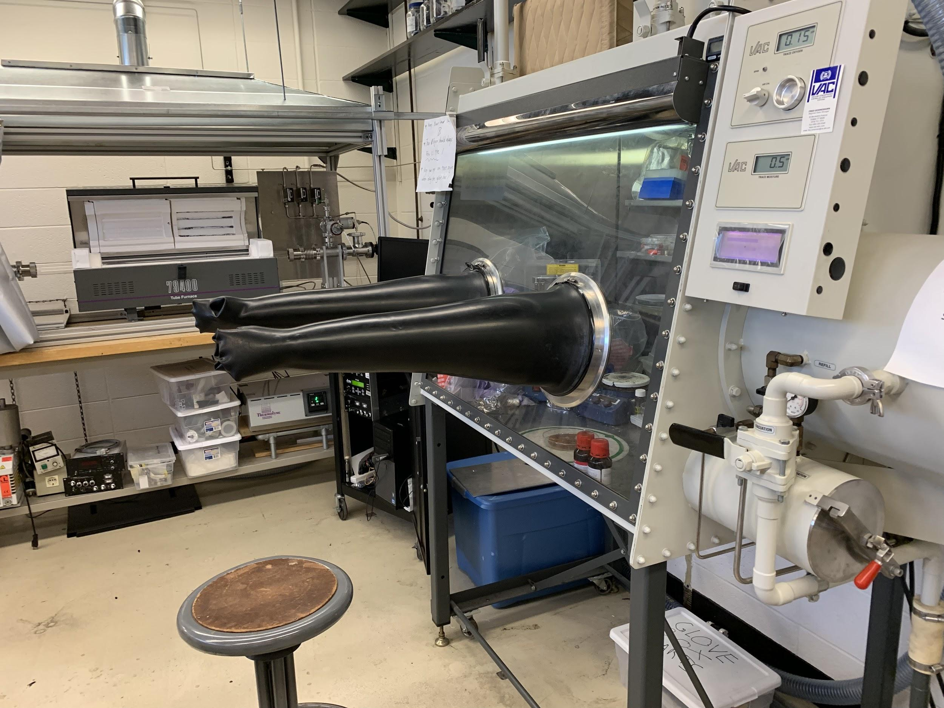
Research Training Received
We’ve been trained in several procedures:
Creation of Nickel slurry
Raman Spectroscopy
EDLC Testing
Half cell construction
And more!

Slide 29
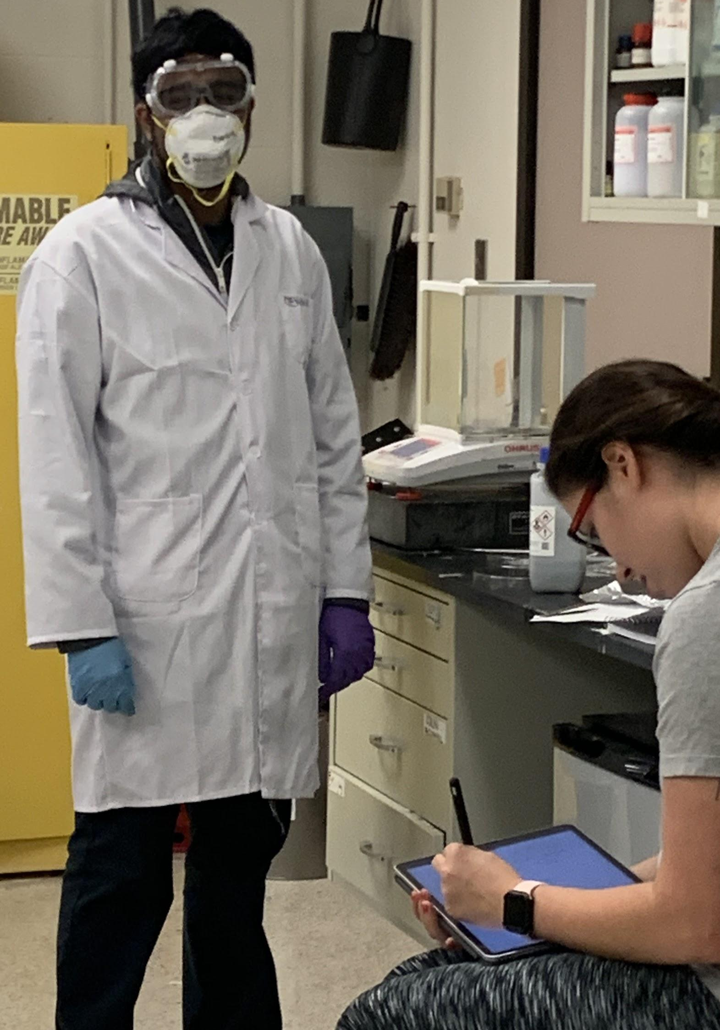
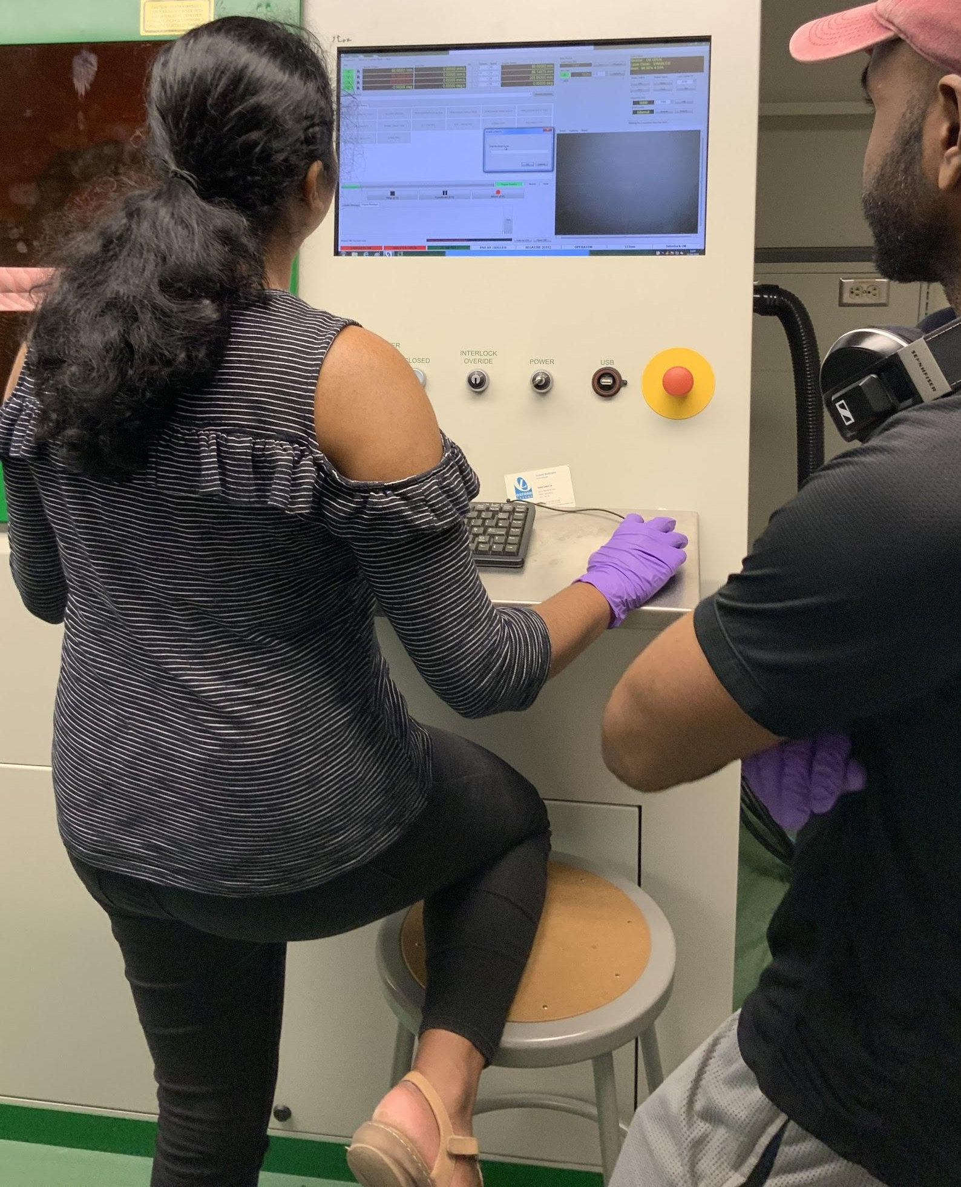
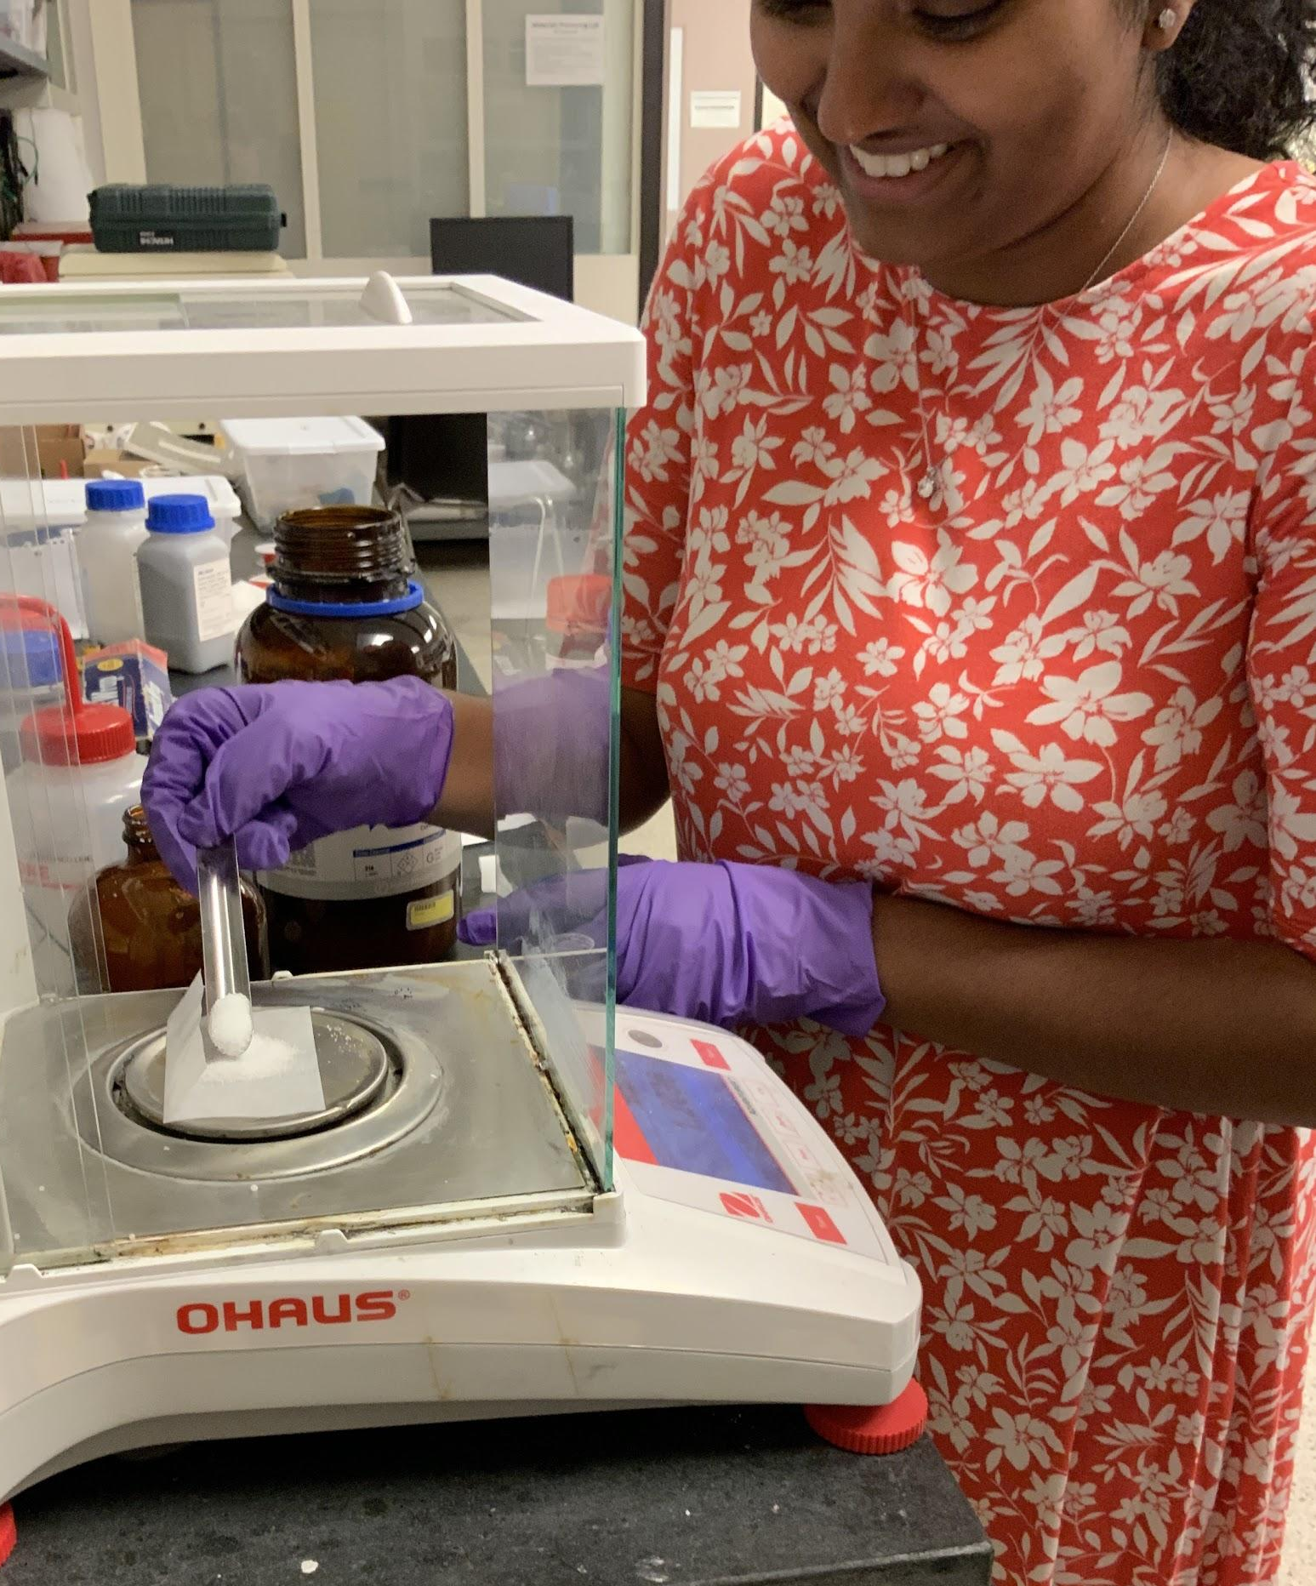
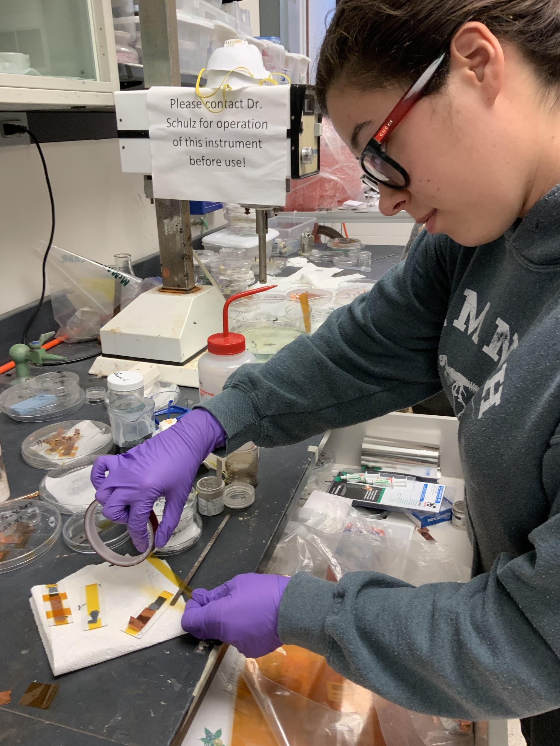

Slide 30
Goals and Objectives of Research
The goal of this research is to demonstrate feasibility of Nitrogen doped Graphene used for commercially available Na⁺ batteries.

Slide 31
Our Results So Far!

Slide 32
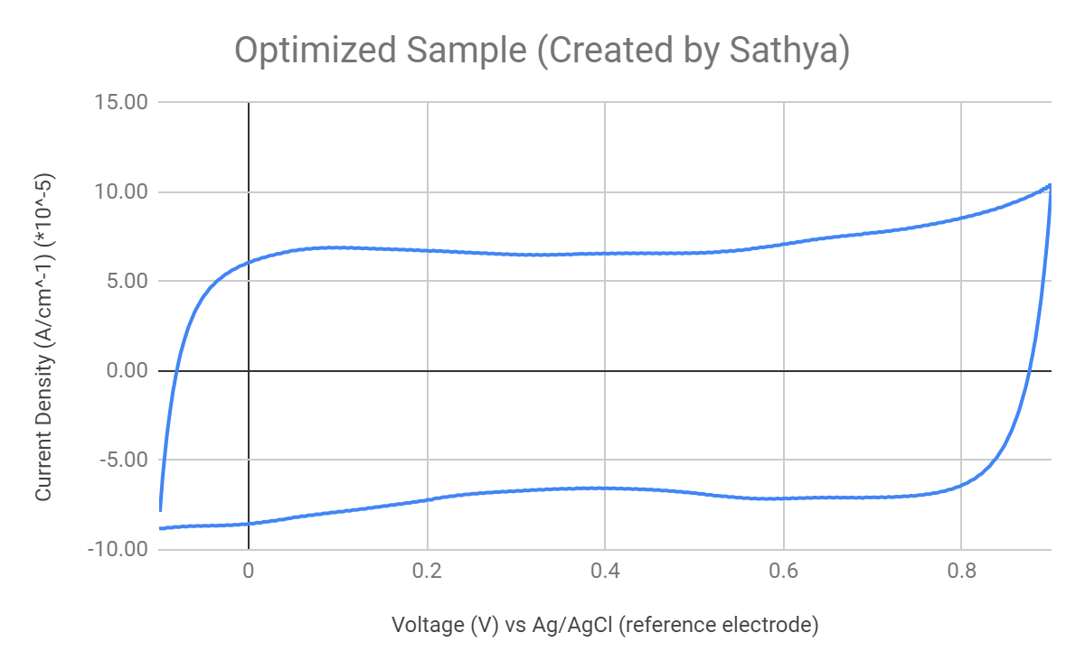
Cyclic Voltammetric Test Results

Slide 33
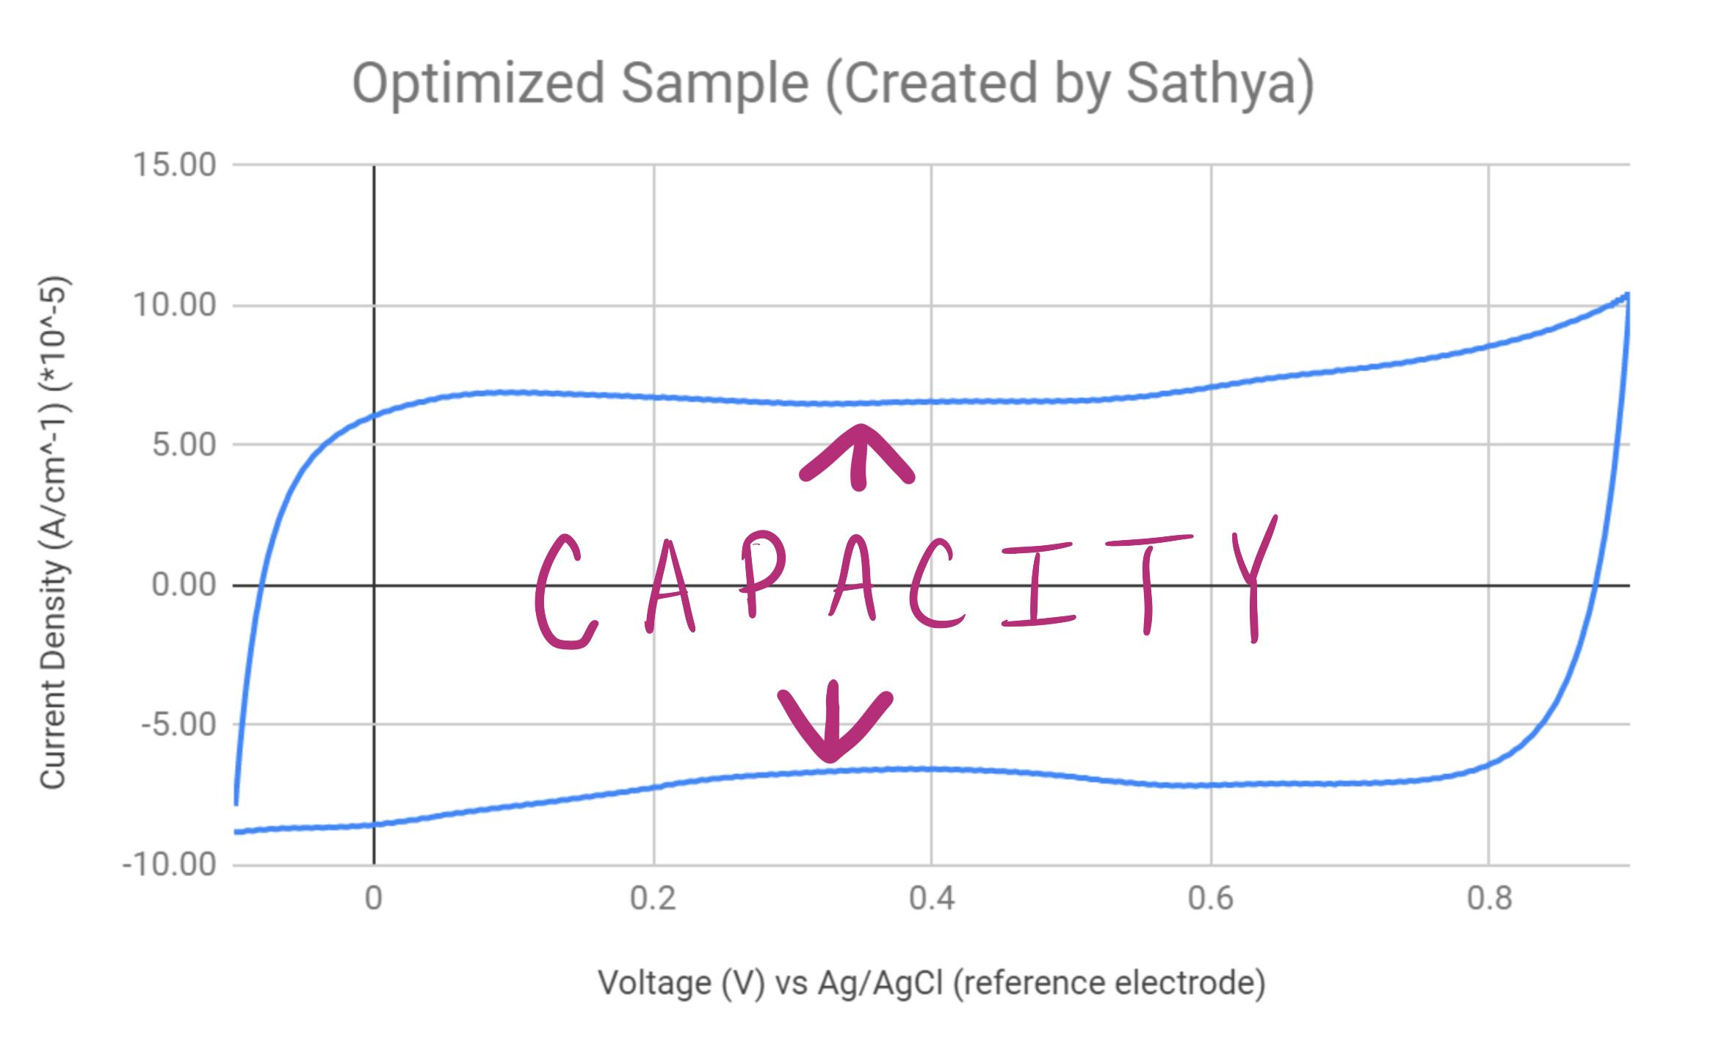

Slide 34
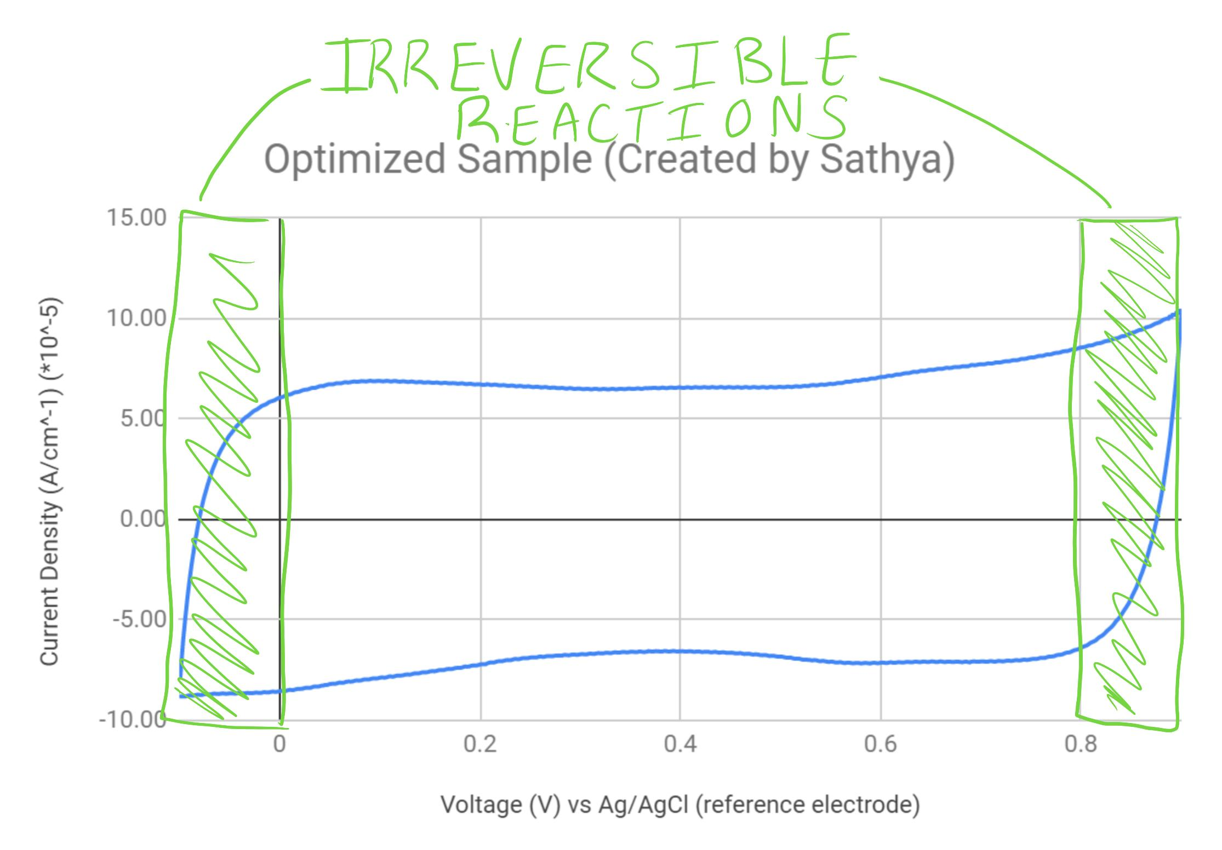

Slide 35
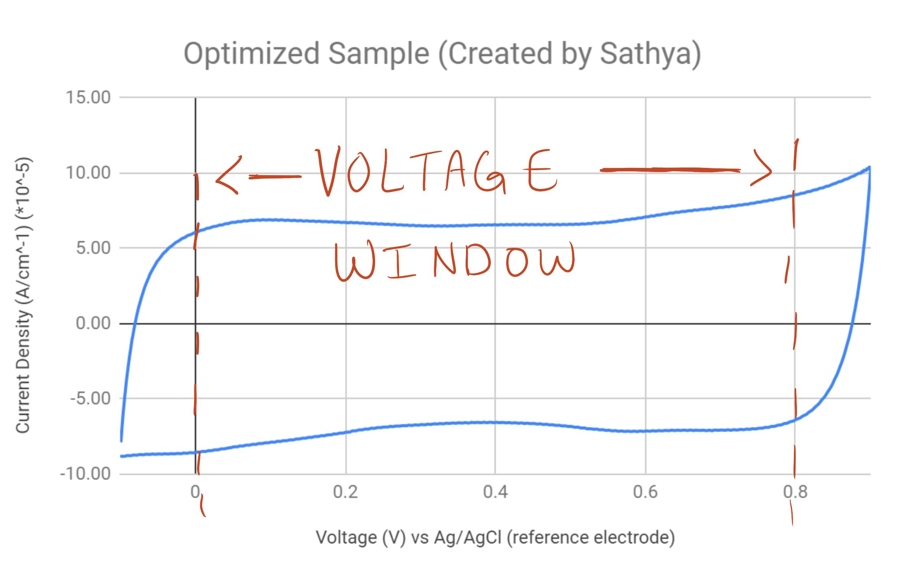

Slide 36
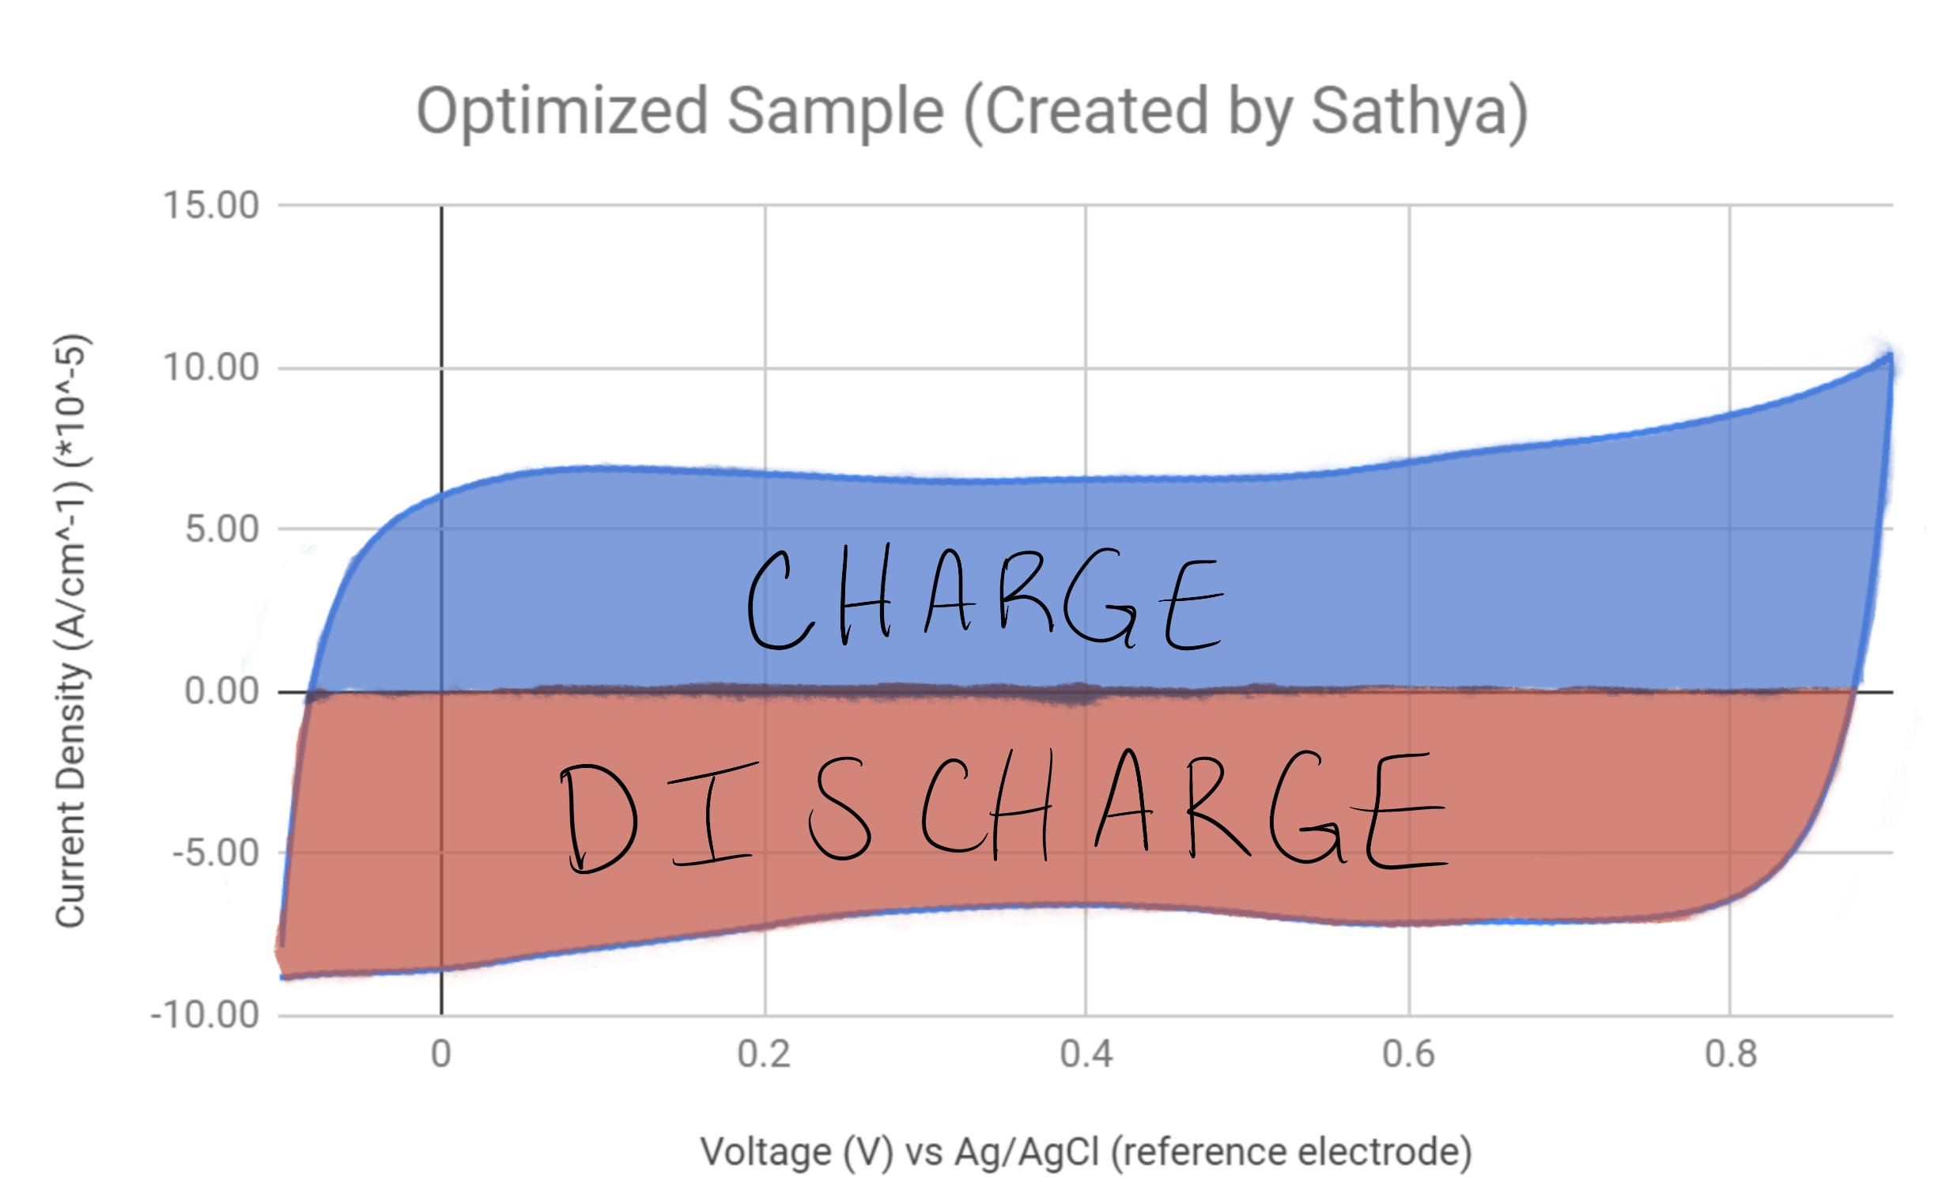

Slide 37
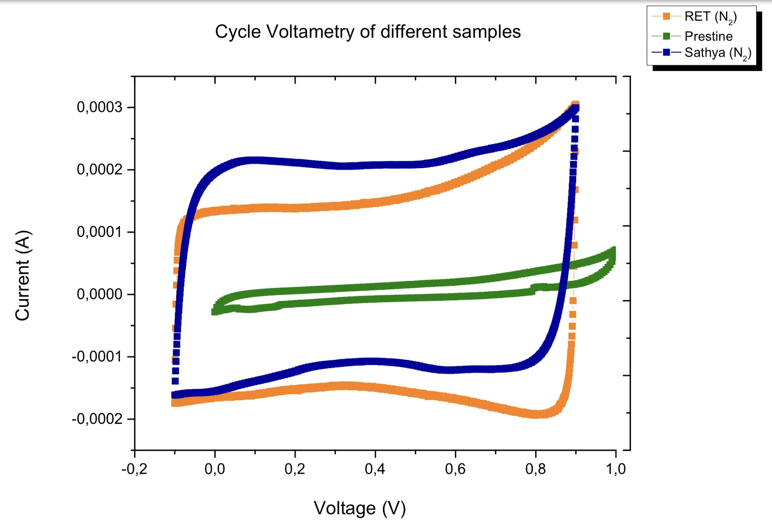

Slide 38
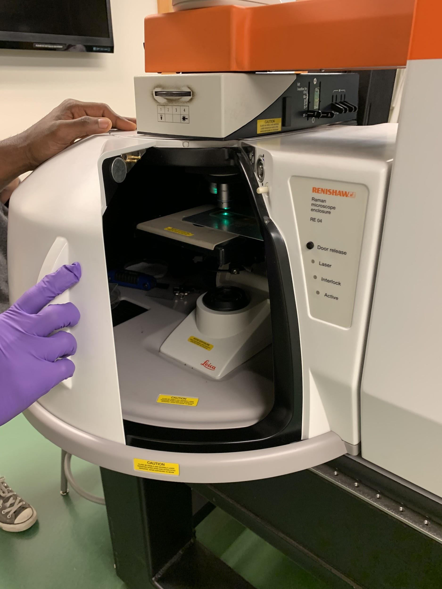
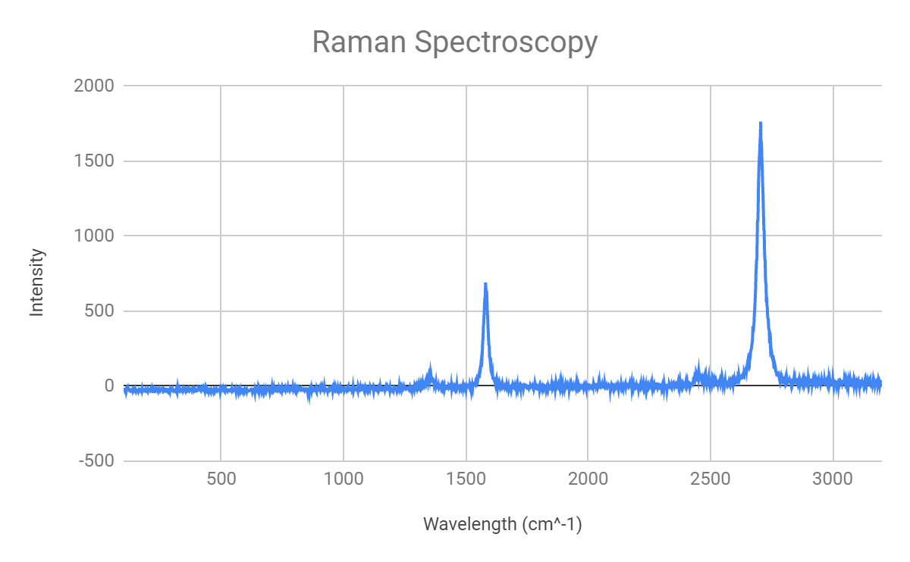
Ramen Spectroscopy Results

Slide 40
Ratio for RET sample: 19.3
We’ve created single layer graphene - which is highly desirable!

Slide 41
Optimizing Everyday Objects
Big Idea:
How can we use the Engineering Design Process to optimize an everyday object? (Stairs)
Essential Questions:
Why do staircases fail?
What are the required/optimal features of a staircase?
How can we optimize dysfunctional staircases uses distance, slope, and the foundations of coordinate geometry?

Slide 42
Unit Overview
Activity 1: Engineering a Duck
Activity 2: When Staircases Fail
Activity 3: Engineering a Staircase
Activity 4: Presentation
Challenge: Optimize a staircase design using Engineering Design Process
Theme: Optimization

Slide 43
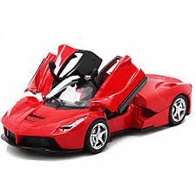
Unit Topic - Victoria
Big Idea:
How can we design transportation that is effective and eco friendly using battery technology?
Essential Questions:
How do we use chemistry to design batteries?
How do we test batteries to determine their abilities?
How and why do we store energy?
What are the advantages of electric vehicles as opposed to gasoline vehicles?
What are the pros and cons of different battery types and arrangements?

Slide 44
Unit Overview
Activity 1: Modeling voltage
Activity 2: Electroplating copper
Activity 3: Optimizing electrolytes in batteries
Activity 4: Optimizing series versus parallel batteries
Challenge: Optimize a small electric vehicle
Theme: Optimization

Slide 45
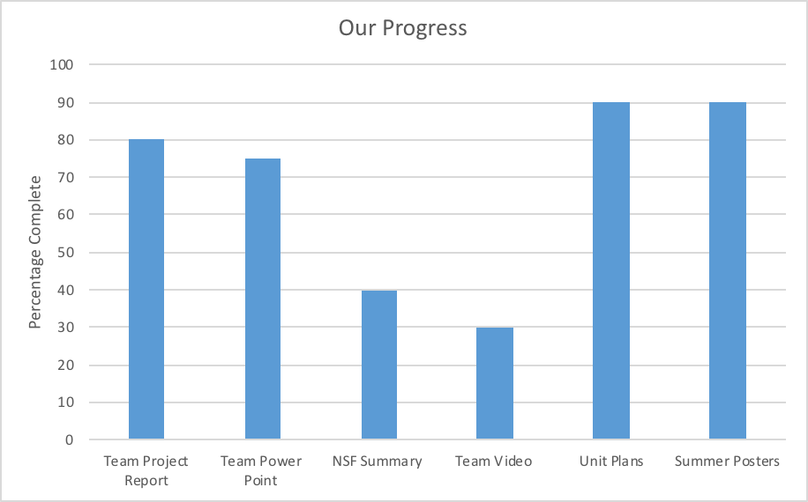
Deliverables

Slide 46
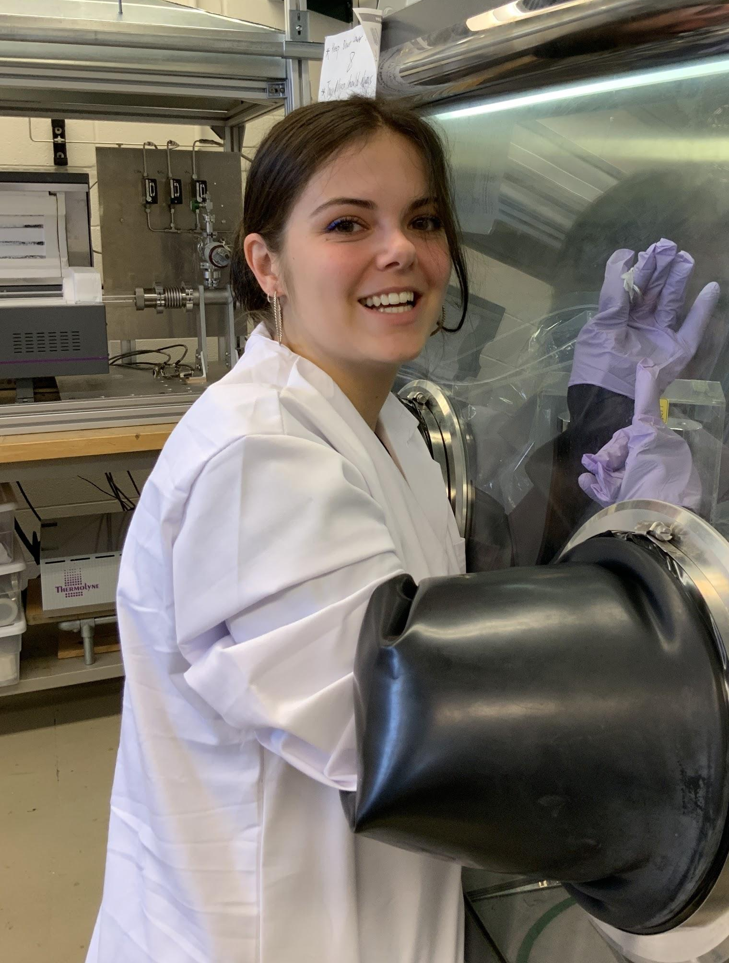
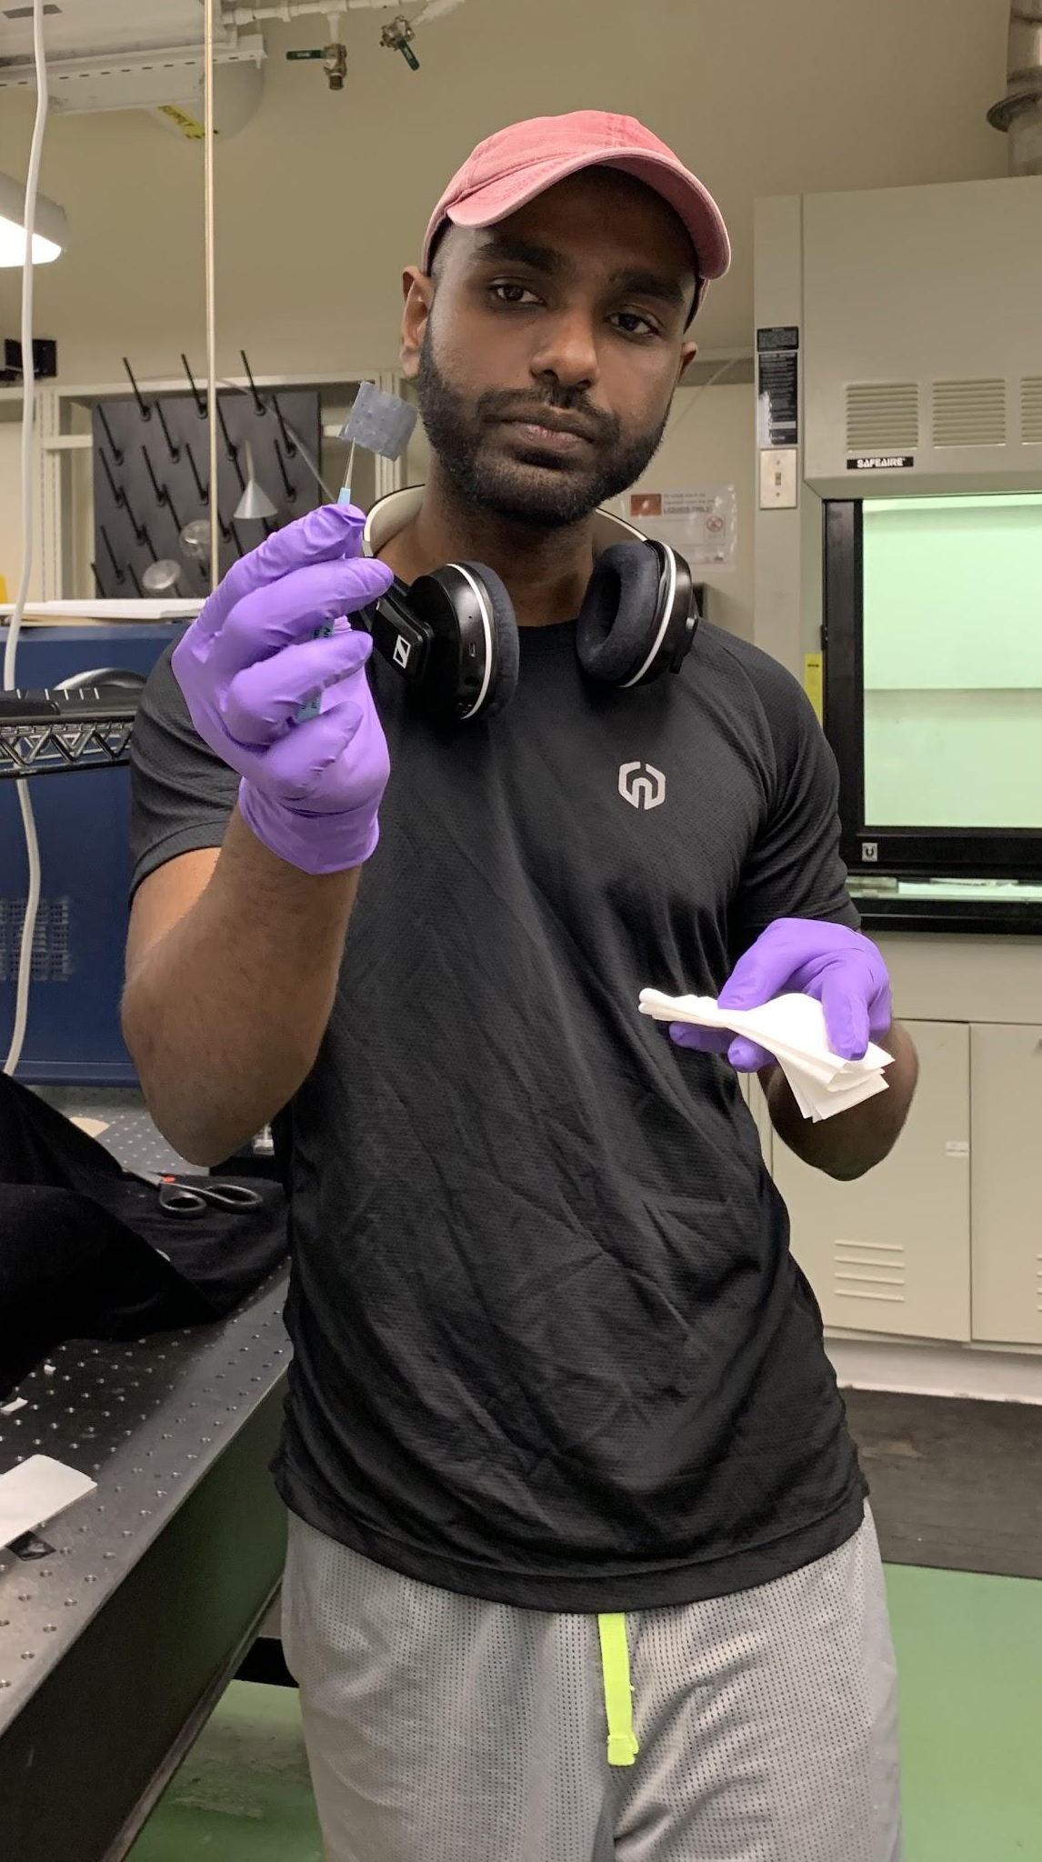

Slide 47
Thank You!
Special Thanks to:
Dr. Vesselin Shanov
Sathya Kanakaraj
Dr. Margaret Kupferle
Lora Buchanan
Pamela Truesdell
NSF Grant : EEC-1710826
University of Cincinnati
RET Program
UC RET Program
NSF Grant: Engineering Design Challenges and Research Experience for Secondary and Community College Teachers
EEC-1710826

